Slide 1

November 9 WASDE Recap
Mac Marshall, VP Market Intelligence, USB/USSEC
@_YoSoyMac

Slide 2
Key Revisions to New Crop (21/22) Soy Balance Sheets for November
United States
21/22
  US soybean yield revised down by 0.3 bu/ac to 51.2 bu/ac – production revised down by 23 m bu to 4.425 billion bushels (120.4 MMT)
  Export projection revised down by 40 million bushels (1.1 MMT) to 2.050 billion bushels (55.8 MMT)
  Ending stocks revised up by 20 million bushels to 340 million bushels (9.3 MMT)
  MY avg price lowered from $12.35/bu to $12.10/bu
  SBO carryout up 114 m lbs on higher carryin
International
21/22
  World ending stocks revised down by 0.79 MMT to 103.78 MMT
  World production revised down by 1.1 MMT
  Argentina harvested area revised down by 500 kHa
  Argentina production revised down by 1.5 MMT
  Argentina ending stocks revised down by 1.1 MMT
  Brazil exports revised up by 1 MMT to 94 MMT
  China imports revised down by 1 MMT to 100 MMT
  India imports revised up by 100 KMT
  India production revised up by 900 KMT
  India domestic use revised up by 780 KMT
Data Source: USDA PSD, updated November 2021.
Notes:
12/1

Slide 3
Key Revisions to 20/21 Soy Complex for November
United States
20/21
  No changes to old crop whole soybean balance sheet
  SBO ending stocks revised up by 114 million lbs
  SBO food/feed/other use down 123 million lbs
  SBO biofuels use up 50 million lbs
  Domestic SBM use revised up by 130 million lbs; exports revised down by 132 million lbs
International
20/21
  Brazil production revised up 1 MMT to 138 MMT
  Brazil harvested area revised up by 300 KHA
  Brazil ending stocks revised up by 1 MMT
  Argentina crush revised up by 506 KMT
  China imports revised up 762 KMT
  Egypt imports revised down by 200 KMT
Data Source: USDA PSD, updated November 2021.
Notes:
12/1

Slide 4
November 9 WASDE – Prerelease Estimates
?
?
Sources: Refinitiv, USDA

Slide 5
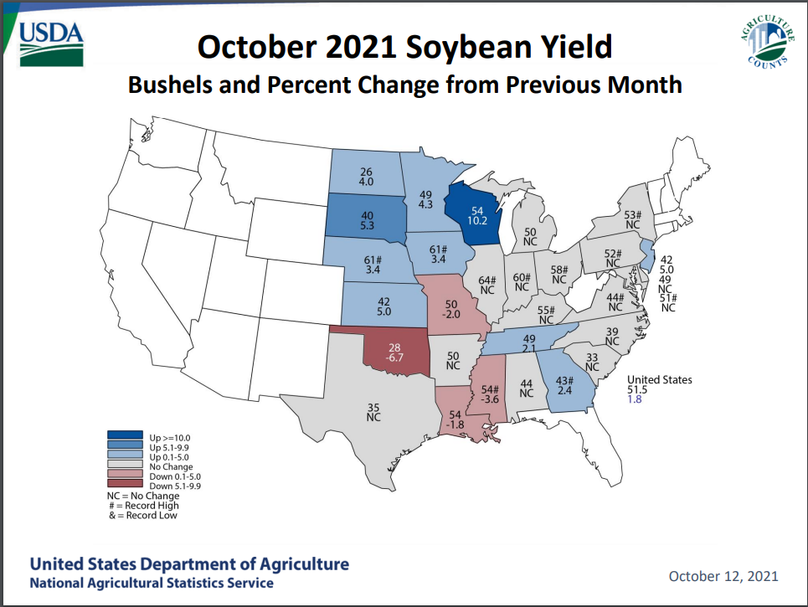
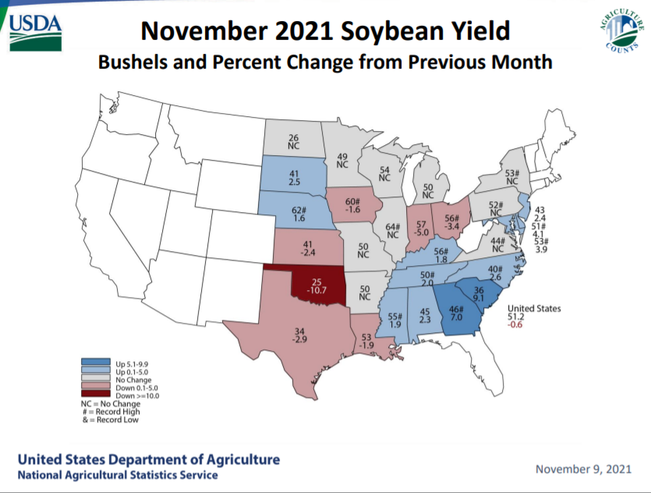
State Yield Estimates – Change from October
Source: USDA NASS

Slide 6
November 9 WASDE – Prerelease Estimates
Sources: Refinitiv, USDA

Slide 7
Revisions in US Balance Sheet – MY 20/21
Data Source: USDA PSD, updated November 2021.

Slide 8
Revisions in US Balance Sheet – MY 21/22
Data Source: USDA PSD, updated November 2021.

